Slide 1
Formal Methods in Software Engineering
Lecture # 01
Introduction to Formal Methods

Slide 2

Objectives
In this course students will learn how to represent computing systems with both state-based and process based algebra models.
They specify computing systems formally,
reason about specifications,
and verify their properties.
They connect specifications to programmes through
Refinement and
decomposition.
They use theorem proving and model checking tools.

Slide 3

Book
The b method an introduction by Steve Schneider

Slide 4

Grading Policy
Quizes 10%
Assignments 5%
Project 10%
Mid Term 25%
Final Exam 50%

Slide 5
Why Formal Methods are required?
History of software bugs
Softwares encountered notorious bugs that were the cause of financial lose and deaths of many people.
Famous bugs are

Slide 6
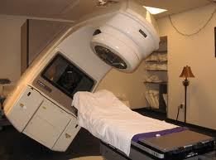
Famous bugs contd..
Therac-25 (1985-1987)
computerized radiation therapy machine called the Therac-25.
killed many people, controller could not stop radiation due to software bug, later on the problem was fixed, after killing many people life.

Slide 7
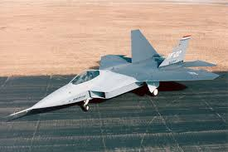
Famous bugs contd..
In April 1992 the first F-22 Raptor crashed while landing at Edwards Air Force Base, California.
The cause of the crash was found to be a flight control software error

Slide 8

The Millennium Bug, or Y2K
two digits were used to show the date, e.g. 98 instead of 1998,
the year 2000 could only be represented as ’00′, which might confuse computers into thinking it meant the year 1900

Slide 9

Famous bugs contd..
Pentium bug
software error in microcode of Pentium microprocessor, which resulted in error of floating point calculations problems.
Intel had to take back all the Pentiums, and it caused huge loss of dollars.

Slide 10
Apple Maps gives us directions to nowhere (2012)

Slide 11

Importance of Software
Software is present everywhere microwave oven, cars and software use is expanded.
That means a small software error can cause your microwave oven to explode, where system failure can cause losses more than the system itself.
A software problem can cause life loses.
We have to be careful for the use of such systems, where loss of life is a bigger loss.

Slide 12


Importance of formal methods in Software
This is what we are going to study in formal methods.
Methods to ensure that software is
Correct
Reliable

Slide 13
Importance of formal methods in Software contd..
These two attributes deal with the software quality.
To achieve software quality, we apply different techniques.
Testing
Verification
Validation

Slide 14
Testing
Black box testing
Test input versus output
Input
Two numbers
Output
average
White box testing
Test the structure of program.
For loops testing, condition testing

Slide 15
Can we test every system?

Slide 16
"Testing can show the presence of errors, but not their absence." - Edsger Dijkstra

Slide 17
Testing contd..
In testing we develop test cases and define scenarios, it is not possible to have all scenarios .
Program to show equality of two strings.
isequal(“cat”, ”dog”) expected false
isequal(“testing”, ”testing”) expected true
isequal(“house”, ”home”) expected false
isequal(“house”,”mouse”) expected false.
No number of test cases assure this.

Slide 18
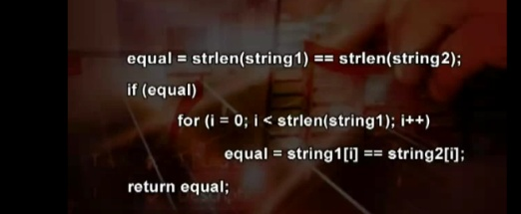
Testing Contd..
Same is case with structural testing, white box testing.
What is wrong with the following code?

Slide 19
Reliability
Obviously there is no guarantee in life but every one wants to have reliable software.

Slide 20
If ,You fly in a plane 100 times plane crashes 5 times due to software error then ,will you travel through plane?

Slide 21
Model Based Verification Techniques
These verification techniques are based on models describing the possible system behavior in a mathematically precise and unambiguous manner.
prior to any form of verification
the accurate modeling of systems often leads to the discovery of incompleteness, ambiguities, and inconsistencies in informal system specifications

Slide 22
Model Based Verification Techniques contd..
The system models are accompanied by algorithms that systematically explore all states of the system model.
This provides the basis for a whole range of verification techniques ranging from an exhaustive exploration (model checking) to experiments with a restrictive set of scenarios in the model (simulation), or in reality (testing).

Slide 23
Any verification using model-based techniques is only as good as the model of the system.

Slide 24
Model checking is a verification technique that explores all possible system states in a brute-force manner.
Similar to a computer chess program that checks possible moves, a model checker, the software tool that performs the model checking, examines all possible system scenarios in a systematic manner.

Slide 25
In this way, it can be shown that a given system model truly satisfies a certain property.
It is a real challenge to examine the largest possible state spaces that can be treated with current means, i.e., processors and memories.

Slide 26
Typical properties that can be checked using model checking are of a qualitative nature.
Is the generated result OK?, Can the system reach a deadlock situation, e.g., when two concurrent programs are waiting for each other and thus halting the entire system?
But also timing properties can be checked:

Slide 27
Model checking has been successfully applied to several ICT systems and their applications.

Slide 28
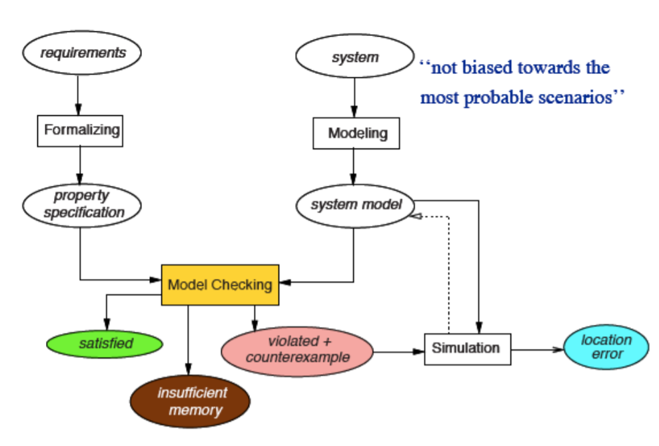

Slide 29
Characteristics of Model Checking
Model checking is an automated technique that, given a finite-state model of a system and a formal property, systematically checks whether this property holds for (a given state in) that model.

Slide 30
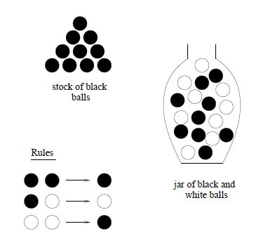
Dijkstra’s game

Slide 31
Dijkstra’s game contd..
Consider the following game to be played by a single person with an urn/jar and as many w white balls and b black balls as he needs.
To begin with, an arbitrary positive number of balls is put into the urn and as long as the urn contains two or more balls, the player repeats the following moves:
he shakes the urn and, without looking, he takes two balls from the urn;

Slide 32
Dijkstra’s game contd..
Rule 1
if those two balls have the same color
he throws one black ball into the urn,
Rule 2
otherwise he returns one white ball into the urn
Because each move decreases the total number of balls into the urn by 1, the game is guaranteed to terminate after a finite number of moves and it is not difficult to see that the game ends with exactly 1 ball in the urn.

Slide 33
Dijkstra’s game contd..
The question is:
What can we say about the color of the final ball when we are given the initial contents of the urn?’”
Difficult to answer
Lets play the same game with different number of balls.

Slide 34
Dijkstra’s game contd..
One ball game
The game will end without playing
Two balls game
Three different combinations of balls
One Black, one white
One White ,one white
One Black, one black

Slide 35
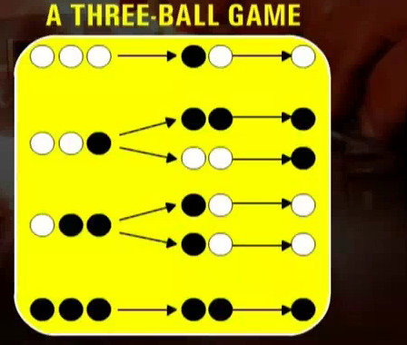
Dijkstra’s game contd..
2 ball game

Slide 36
Dijkstra’s game contd..
Mathematical models use functions.
What is a function?
Function:
Putting the balls in jar is a function

Slide 37
Conclusion from 2 and 3 balls game
Depends on parity of white balls, even or odd parity.
Even number of white balls, last ball is black color.
Odd number of balls, last ball is of white.
If we play with 100 balls, then can we argue or prove our hypothesis?
What is the color of last ball, given w white balls and b black balls?

Slide 38
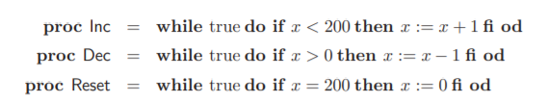
What is the output of following code?

Slide 39
Mathematical model and its proof
F(b,w)=
2 black out,1 black in b-2+1, (b-1,w)
We reduce the number of black balls by 1 and we maintain the number of white balls.
2 white out,1 black in w-2,b+1
We reduce the number of white balls by 2 and increase the number of black balls by 1.
1 of each out,1 white in b-1,w-1+1=(w)
we reduce the number of black balls by 1 and maintain the number of white balls.

Slide 40
Mathematical model and its proof contd..
Total number of balls removed in each move is 1.
Parity(even/odd number) of white balls does not change.
Yes we will say the parity of white balls determine the outcome of the game.
Hence hypothesis is correct.

Slide 41
The Model-Checking Process
Modeling phase
model description language of the model checker at hand;
as a first sanity check and quick assessment of the model, perform some simulations;
formalize the property to be checked using the property specification language.

Slide 42
Running phase:
run the model checker to check the validity of the property in the system model.
Analysis phase:
property satisfied? → check next property (if any);
property violated? → 1. analyze generated counterexample by simulation; 2. refine the model, design, or property; 3. repeat the entire procedure. – out of memory? → try to reduce the model and try again.

Slide 43
the entire verification should be planned, administered, and organized. This is called verification organization.
Running the Model Checker
The model checker first has to be initialized by appropriately setting the various options and directives that may be used to carry out the exhaustive verification.

Slide 44
the actual model checking takes place. This is basically a solely algorithmic approach in which the validity of the property under consideration is checked in all states of the system model.

Slide 45
Analyzing the Results
There are basically three possible outcomes: the specified property is either valid in the given model or not, or the model turns out to be too large to fit within the physical limits of the computer memory.
We analyze the validity of property

Slide 46
Modeling error
Property error
Design error

Slide 47
ModelinG
finite-state automata
temporal logic

Slide 48
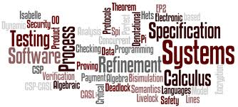
Formal Method
The Encyclopedia of Software Engineering defines formal methods in the following manner:
Formal methods used in developing computer systems are:
mathematically based techniques for describing system properties. Such formal methods provide frameworks within which people can:
specify, develop, and verify systems in a systematic, rather than ad hoc manner.

Slide 49
Formal Method definition
A method is formal if it has a sound mathematical basis, typically given by a formal specification language.
This basis provides a means of precisely defining notions like:
consistency
completeness, and more relevantly specification,
implementation and correctness.

Slide 50
Formal Method definition contd..
Correctness:
the property that an abstract model fulfills a set of well defined requirements.
Consistency:
to be consistent, facts stated in one place in a specification should not be contradicted in another place.

Slide 51
How Formal Methods are applied?
We develop models of system.
With the help of models we will argue and prove correctness of models.
Formal Method has 2 parts:
Logical Theory:
Means by which one reasons about specifications, properties and programs predicate calculus, (logic ,propositions).
Structuring Theory:
Defines elements being reasoned about.

Slide 52
Formal method steps
We will define state based model for our computer programs using formal methods.
Define the specifications of the system(InFormal specification).
Define abstract model of specifications.
Define the states of system (steps of a model)
Define invariant(condition)
Define set of operations for model to function.
System/model operation is associated with two conditions
Pre-condition
Post condition
Model verification and Implementation
Make formal model and use tools to prove mechanically that formal execution model satisfies formal requirements.

Slide 53
Model types
Two types of models are defined
Abstract model
abstraction is the process by which data and programs are defined with a representation similar to its pictorial meaning.
High level system design
Concrete model
Detailed model of the system achieved after refinement of abstract model.

Slide 54
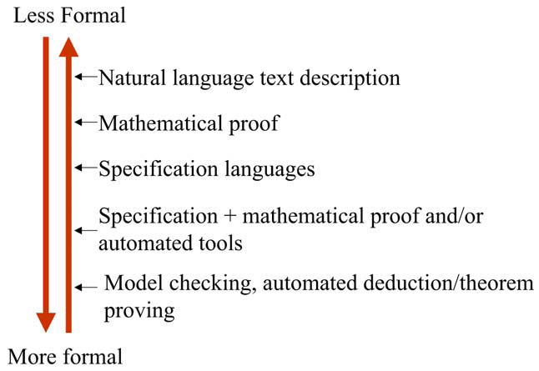
Formalization Spectrum

Slide 55
Examples of Formal Methods
Formal methods can include graphical languages.
For example,
Data Flow Diagrams (DFDs)
Petri Nets
Finite State Machines FSM

Slide 56
Use of Formal methods
There is an increasing interest about formal methods and their applications.
Formal methods have the potential to provide increased confidence in a system by satisfying the standards set by regulatory bodies.

Slide 57
Formal methods are not meant to
to show correctness" of entire systems
to replace testing entirely
Formal methods work on models, on source code
to replace good design practices
One can't formally verify messy code with unclear specs.
We are not developing(programming) a complete system using Formal methods.

Slide 58
Formal methods are meant for
But ….
Formal proof can replace (infinitely) many test cases
Formal methods improve the quality of specs (even without formal verification)
Formal methods guarantee specific properties of system model

Slide 59
A Fundamental Fact
Formalization of system requirements is hard.
But we can formalize critical features/requirements of system.

Slide 60
Tools for formal Systems
Pro-B tool
Atelier B
RODIN tool

Slide 61
Summary
Formal methods are used to ensure correctness and reliability of software systems
Formal methods are based on mathematical models.
Formal methods are difficult to apply but results are fruitful.
Formal methods does not mean we are programming a part of the system.
We are verifying the system correctness using formal methods.

Slide 62

Questions

